Slide 1
MUZAMMIL BAIG LAB NUMBER # 10
AIT-2024-CIT-M-002

Slide 2
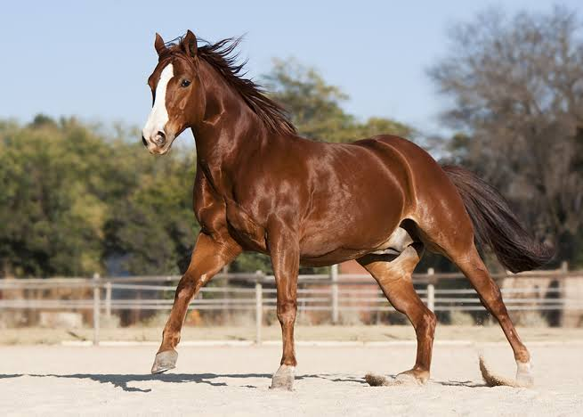
HORSE:The most beautiful and one of the strongest animals in the world to have been domesticated by human beings is a horse. They have been with human civilisation for thousands of years now.

Slide 3
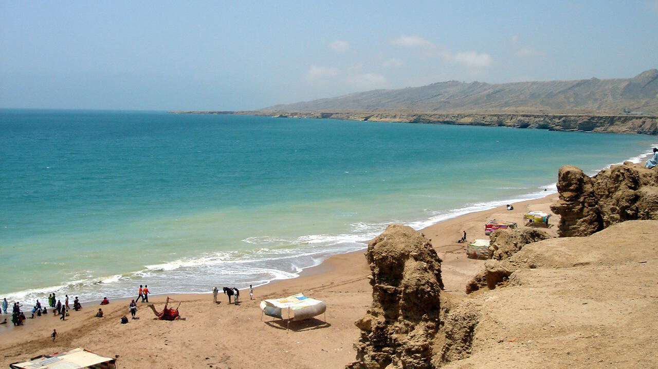
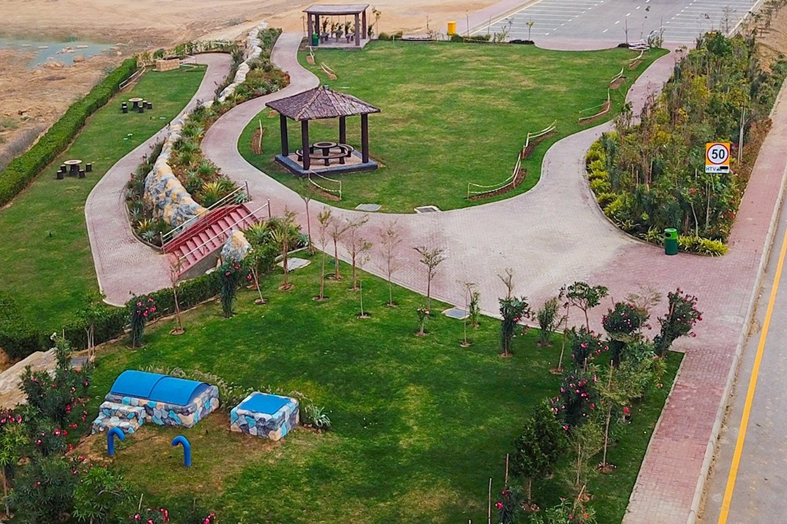
PICNIC PLACES : Picnics are the best ways to spend quality time with our family members. During picnics, we get to talk a lot to each other and play together. When we are on a family picnic, we start our journey to the picnic spot early in the morning.

Slide 4
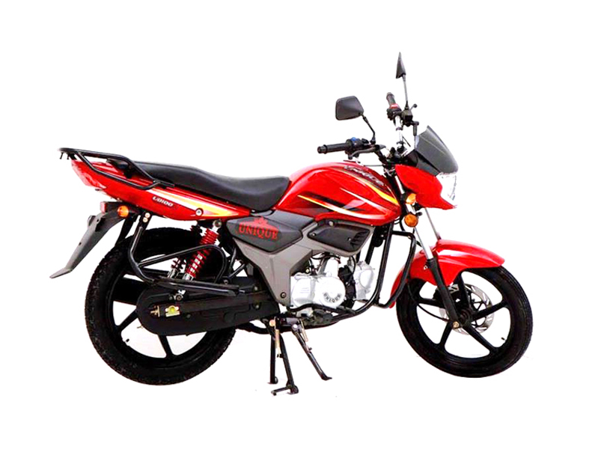
100cc UNIQUE BIKE : the 100cc bike is cost-effective and reduces your overall expenses, its performance is pretty average as it is best for daily commuters.

Slide 5
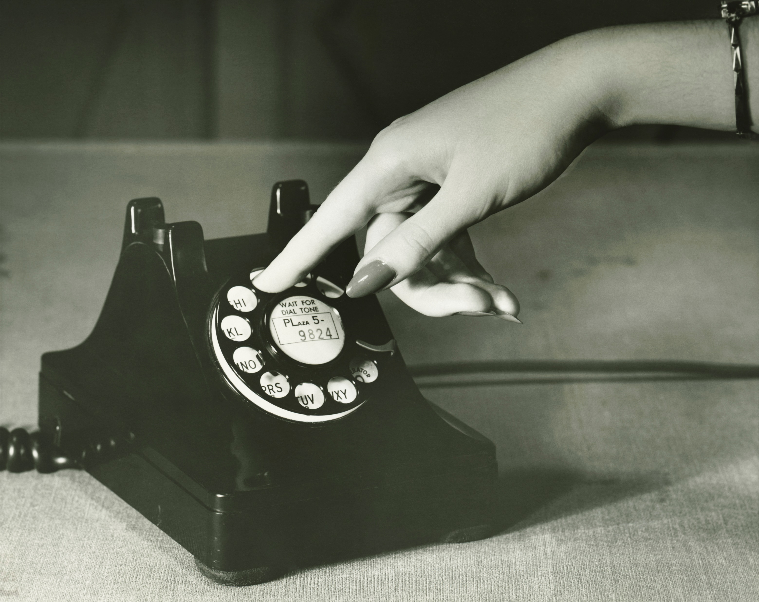
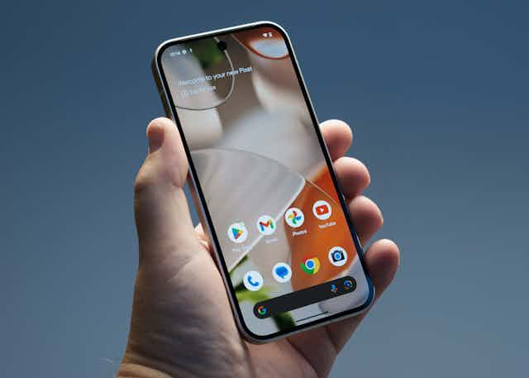
MOBILE PHONES:A mobile phone makes our lives easier. There are two types as:
Traditional Phones : The telephone is a very common device for communicating over a distance.Most telephones are linked to each other by wires.
Smart Phones : The benefits of smart phone Sending and receiving emails, text, photographs and multimedia messages. Registering contacts. functions. Browsing the Internet using a mobile browser.Playing games.

Slide 6
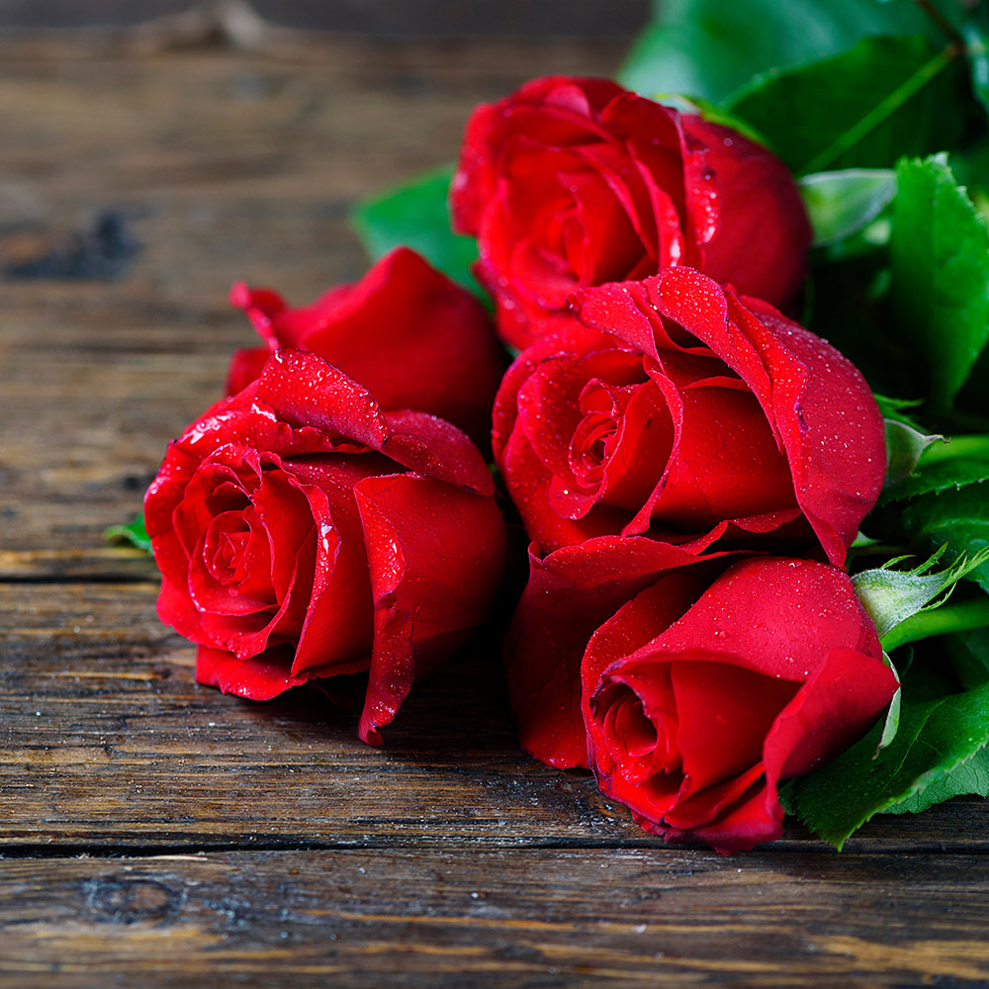
FLOWER:Flowers are an essential part of our lives. They are responsible for bringing happiness in our lives and making our surrounding environment a prettier place to live in

